Slide 1
8.1: Systems of Linear Equations in Two Variables
And Now for Something Completely Different…
MATH 1550 - Precalculus

Slide 2
Types of Systems
Independent System
Inconsistent System
Dependent System
y
y
y
x
x
x

Slide 3
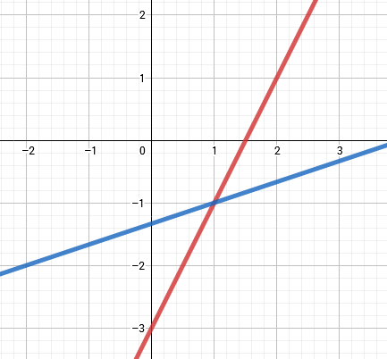
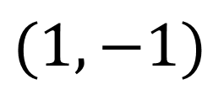
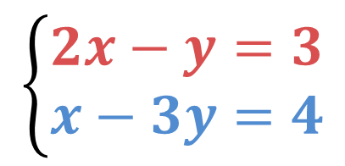
Ex) Find the solution of the system of equations graphically:
$$\left\{\begin{aligned}2x−y=3 \\ x−3y=4\end{aligned}\right.$$
$$(1,−1)$$

Slide 4
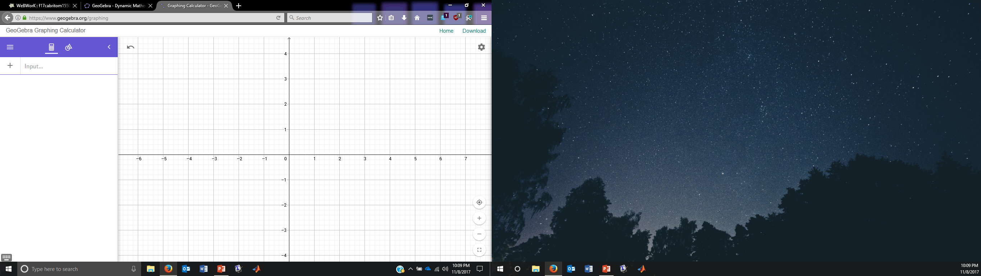
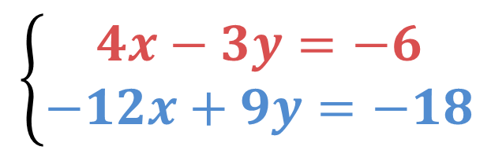
Ex) Find the solution of the system of equations graphically:
$$\left\{\begin{aligned}4x−3y=−6 \\ −12x+9y=−18\end{aligned}\right.$$

Slide 5
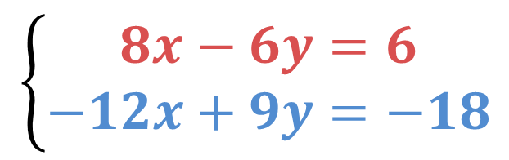
Ex) Find the solution of the system of equations graphically:
$$\left\{\begin{aligned}8x−6y=6 \\ −12x+9y=−18\end{aligned}\right.$$

Slide 6
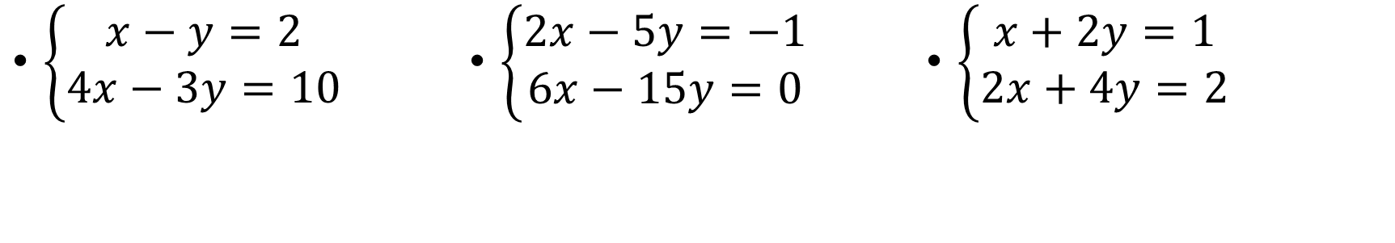
Solve the following systems of equations using the substitution method:
$\left\{\begin{aligned}x−y=2 \\ 4x−3y=10\end{aligned}\right.$
$\left\{\begin{aligned}2x−5y=−1 \\ 6x−15y=0\end{aligned}\right.$
$\left\{\begin{aligned}x+2y=1 \\ 2x+4y=2\end{aligned}\right.$

Slide 7
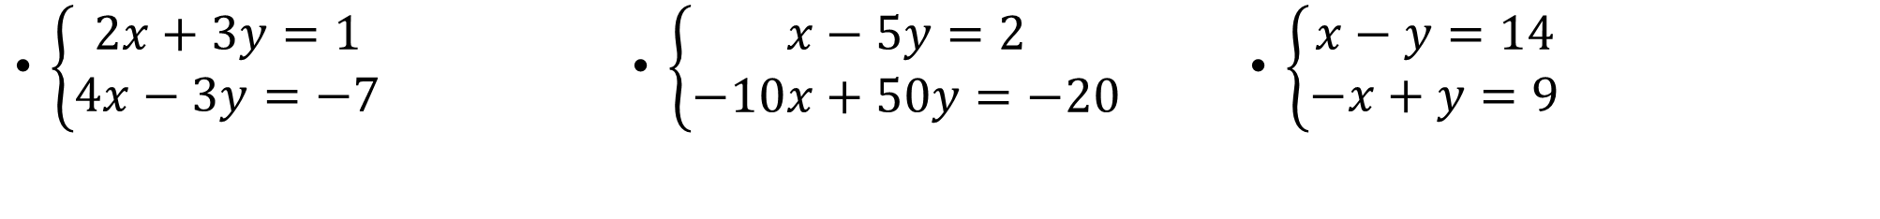
Solve the following systems of equations using the elimination method:
$\left\{\begin{aligned}2x+3y=1 \\ 4x−3y=−7\end{aligned}\right.$
$\left\{\begin{aligned}x−5y=2 \\ −10x+50y=−20\end{aligned}\right.$
$\left\{\begin{aligned}x−y=14 \\ −x+y=9\end{aligned}\right.$

Slide 8
At a restaurant the cost for a breakfast taco and a coffee is $2.10. The cost for two tacos and 3 coffees is $5.15. Give the system of equations that describe the situation, and then find how much a taco costs and how much a coffee costs.

Slide 9
One 8-oz glass of apple juice and one 8-oz glass of orange juice contain a total of 177.4 mg of vitamin C. Two 8-oz glasses of apple juice and three 8-oz glasses of orange juice contain a total of 436.7 mg of vitamin C. How much vitamin C is in an 8-oz glass of each?

